Slide 1
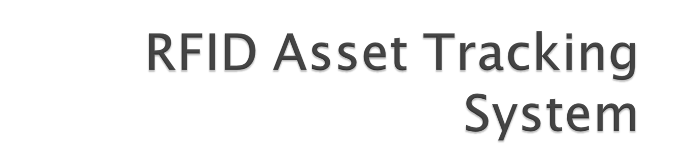
Axon Guidance

Slide 2

Our project sponsor is the NAND Solutions group, a small group at Intel Corporation.
Their job is the validation of Intel Solid State Drives (SSDs).

Slide 3

Currently, SSDs and other tools are frequently misplaced or lost.
There is no way of tracking assets coming in or out of the lab.
Manual searching for items is time consuming and inefficient.

Slide 4

Our goal is to create a tracking system using RFID to monitor all items in the lab.
Users will be able to open a Java applet to query for items and their locations will be shown graphically.
Panel antennas will be installed at the entrances to the lab to track items moving in or out of the room.

Slide 5


Slide 6

Two different users with two different roles
  Lab managers need a system to catalog all tools, systems, and test products.
    Needs to be mobile-device accessible
    Needs to be light, and easy for HR/Legal to add Intel logos/color schemes, etc.
  Lab users need to be able to quickly locate objects that often move around.
    Needs to allow for multiple query criteria (Serial, Make, Model, Description, etc.)

Slide 7

Two integrated applications sharing a common database
  A light administrative tool for the Manager(s)
  A graphical triangulation tool for the Engineers

Slide 8

Client
PHP Web Pages
Java Applet
Server
MS IIS 7
MySQL
RFID Transceiver
Scanning Application

Slide 9

Java Applet:
  Triangulates items on a graphical interface.
  Performs queries based on variety of criteria.
  Gives basic item information on mouseover.
PHP Administration Site
  System / Database administrative features
  Minimalist, mobile-device accessible interface
  Simple and efficient DB management.

Slide 10
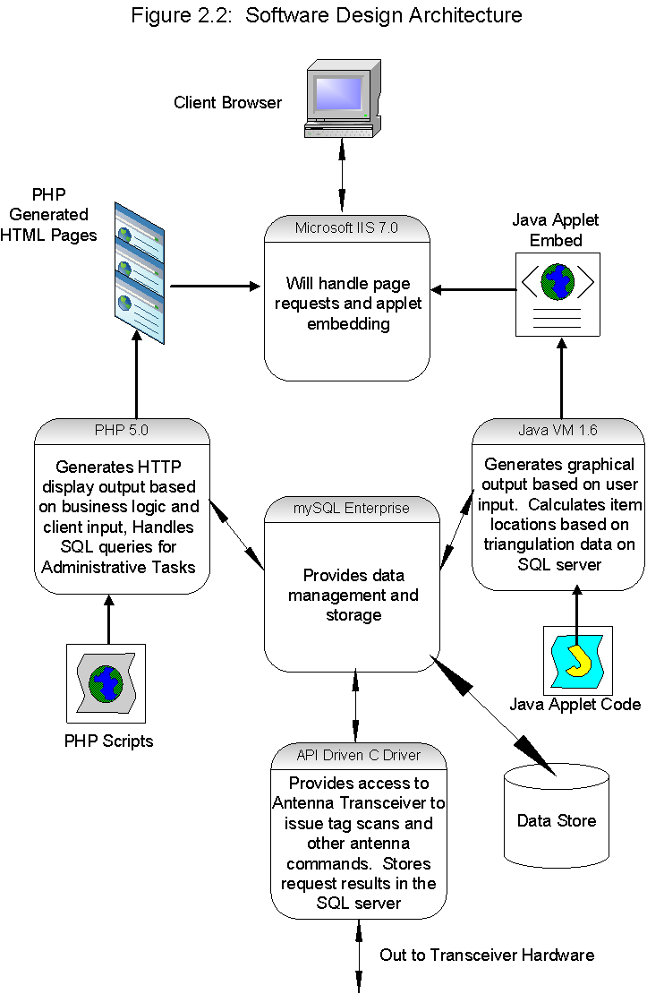

Slide 11

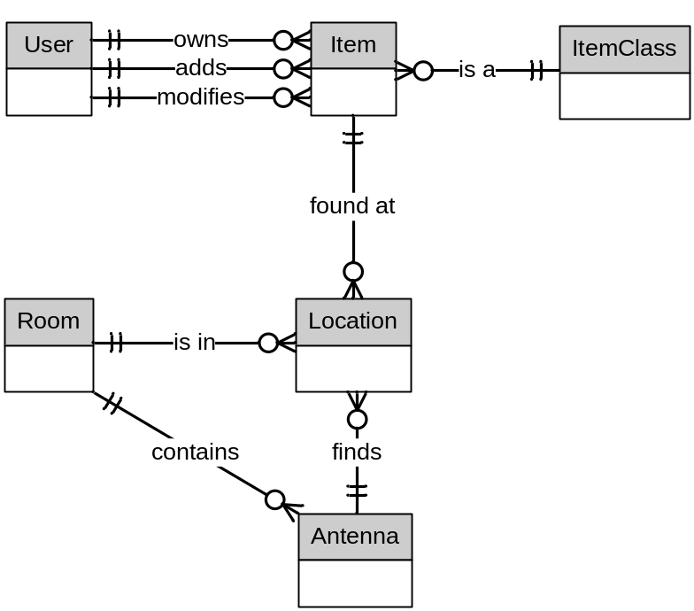
User: Login / Password based accounts
Item: Inventory of tracked objects.
Item Class: Searchable, user-defined
categories for organization.
Location: RFID driver-generated entries
  for use by the triangulation algorithm.
Room: Allows storage of room information
  such as floorplans and dimensions.
Antenna: Keeps track of relative locations
  of antennas in each room, used for
  triangulation.

Slide 12

The Perfect Scenario – In the middle of 4 antennas
Overlapping Responses – Two items very close
Extremely Close Proximity – Right underneath antenna
The Corner Case – Within range of only one corner antenna

Slide 13

Basic Algorithm -
Pull the 4 antennas that return the highest power reading
from the asset.
1. If less than 4 antennas detect the asset
Then Special Case
2. Else If the antennas surround the asset in a rectangular form
Then Triangulate
3. Else Special Case

Slide 14

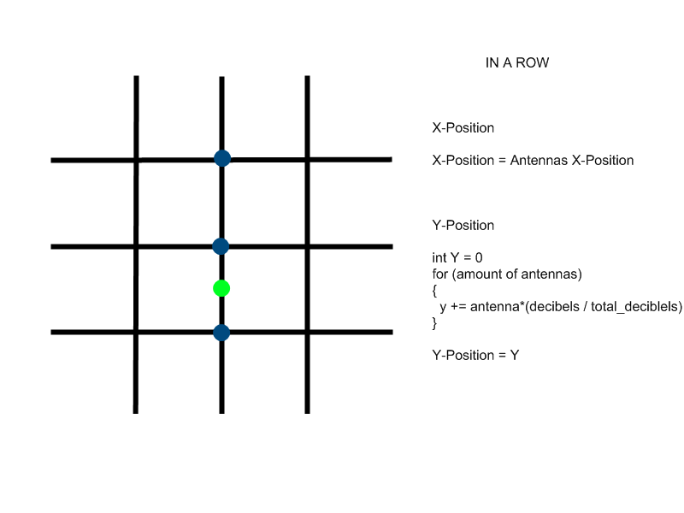


Slide 15
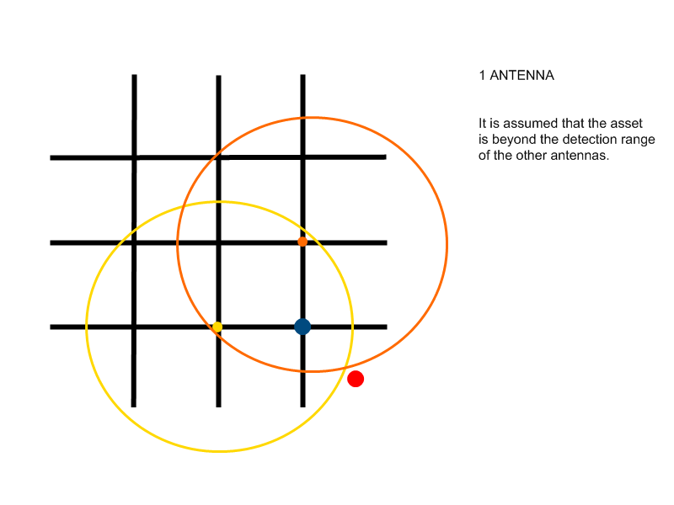

Slide 16
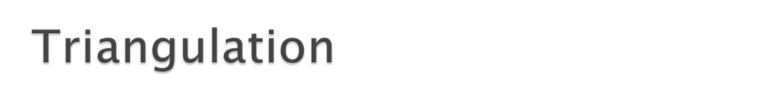
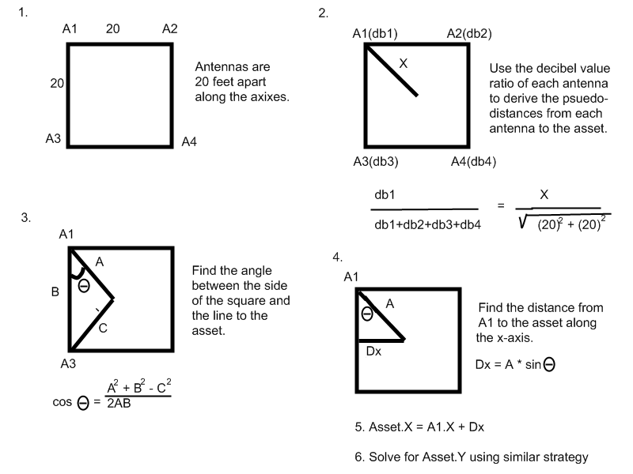

Slide 17

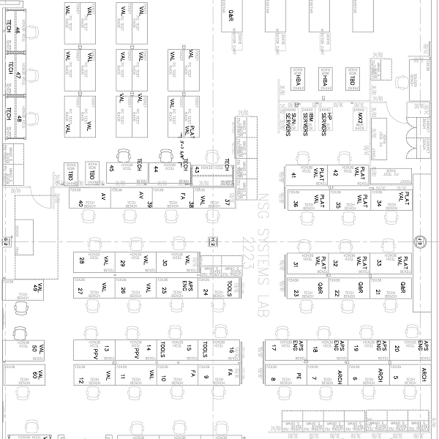
C3
C2
C1
C4

Slide 18


Slide 19

Graphical slowdown when pinging asset.
Comcast going down and taking the database offline.
Multiple backlogged queries would cause application to hang.

Slide 20


Slide 21

Development machine connectivity
Conversion from Java Binary to Applet
Passive RFID limitations
JDBC Performance

Slide 22

The wonderful world of Corporate Restructuring
Intel’s ever-changing mind regarding RFID hardware
FCC compliance
Economy of Scale

Slide 23

Steve’s Magical Medical Mismanagement
Intense school workloads (CS159!)
The thrill of full time employment (Salil and Steve)

Slide 24
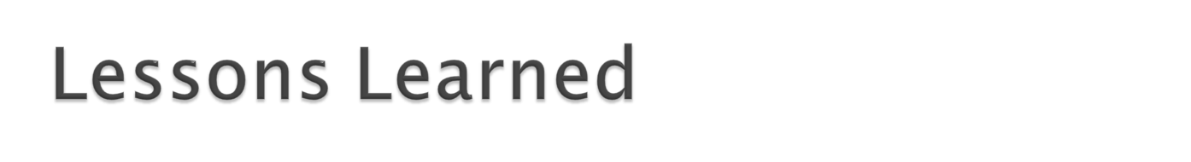
190/191 Documentation is just as much for the sponsor as it is for the developers.
Enthusiasm and direction above all else
Do not rage against the (established) machine.
Comcast is terrible.

